Slide 1
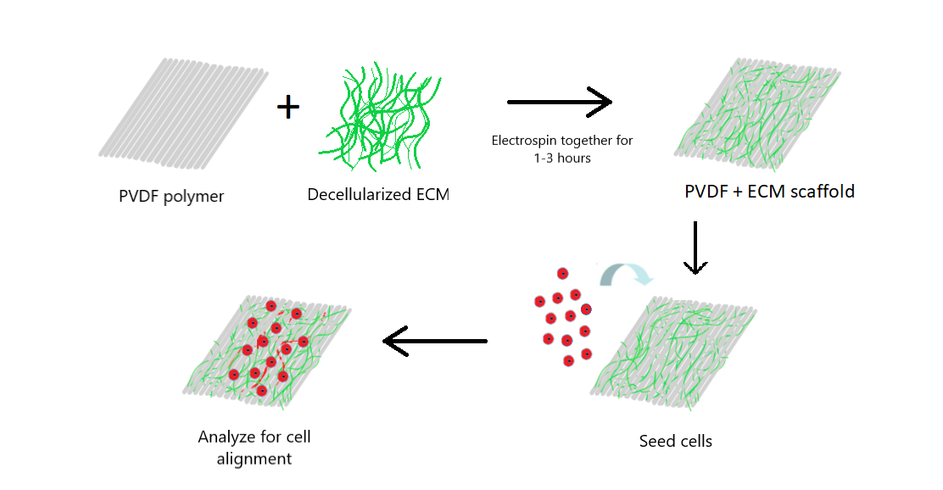
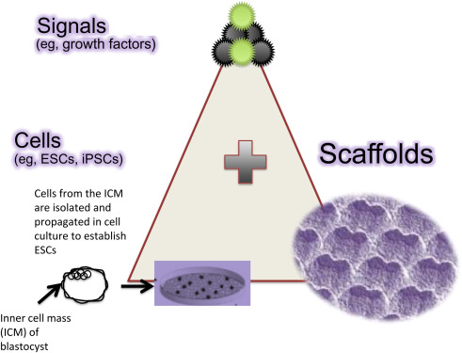
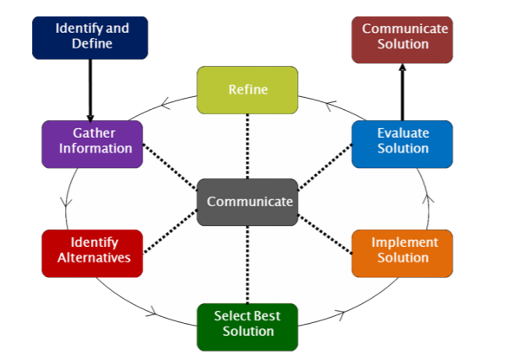
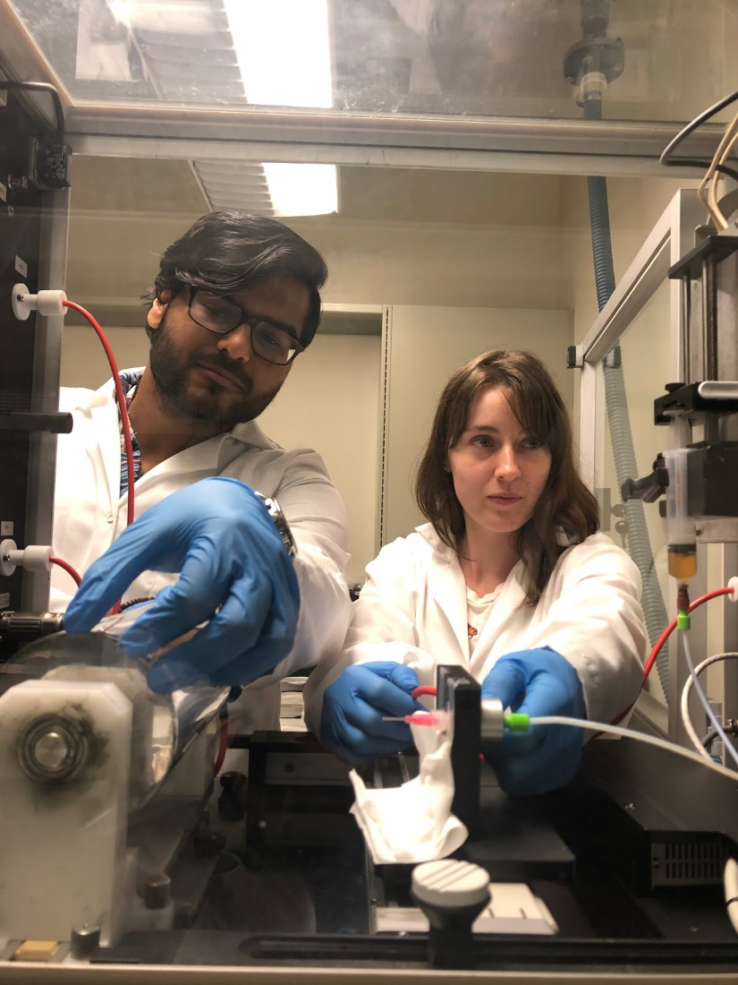
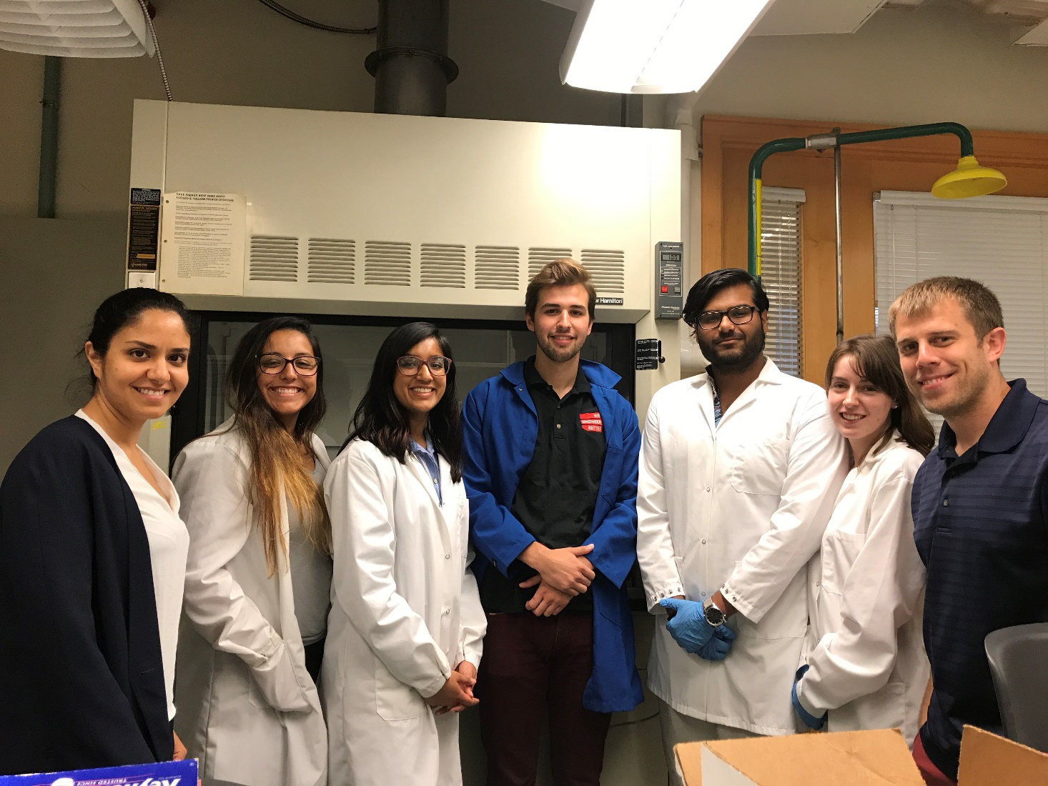
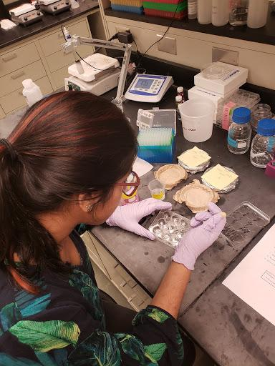
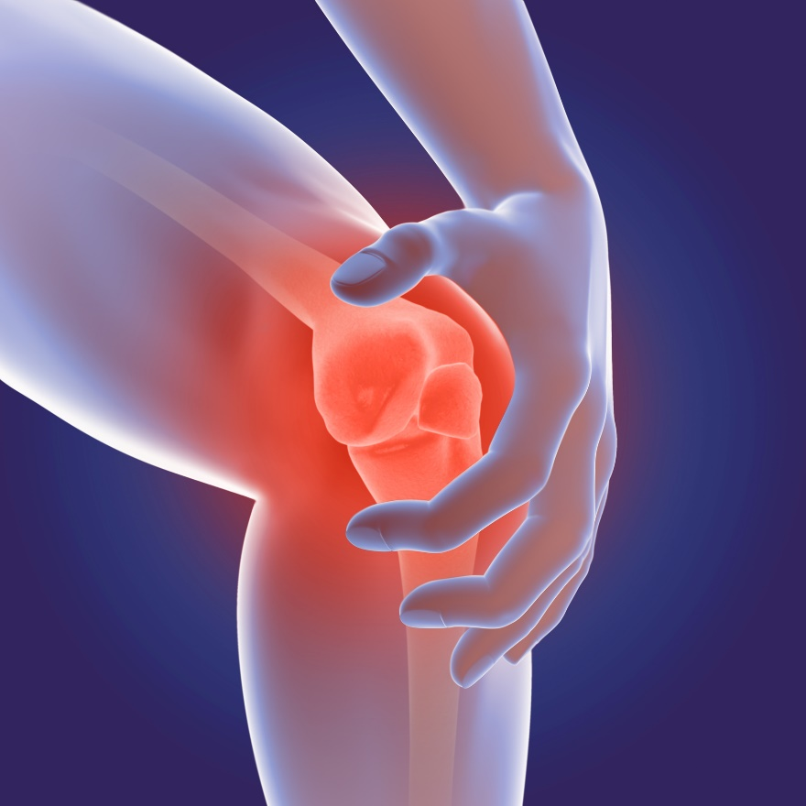
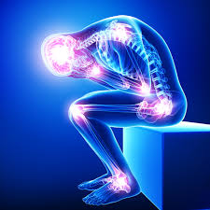
Pain Reactions are Chain Reactions Pain and Feedback Cycles Akshayaa Venkatakrishnan Dater High School, HS Biology
RET is funded by the National Science Foundation, grant # EEC-1710826
Biocompatible Scaffolds for
Clinical Solutions
Connecting Research
to the Classroom
Real World Impact:
What’s the Big Idea?
What is the research?
What are students learning?
Why is this relevant to our society?
Use of Piezoelectric Materials for Peripheral Nerve Repair
Class: High School Biology
Unit: Cell Structure and Function
Topic: Homeostasis and Feedback
Peripheral pain is the leading cause of disability in the USA.
1.7 million Americans suffer from prescription substance abuse.
NGSS Standard: HS-LS1-3. Plan and conduct an investigation to provide evidence that feedback mechanisms maintain homeostasis.
25.3 million Americans suffer from daily pain.
Data from the Nation Institute of Health, 2014.
What are the goals?
What is the Engineering Design Process?
What’s the Big Idea?
Goal: Create a biocompatible and piezoelectric scaffold that helps cells grow and align.
How might we use our knowledge of feedback cycles to design solutions for patients in pain?
How does our body regulate pain?
Why do some diseases cause pain?
How can that pain be relieved?
Do medications fix the problem?
Left: Minhaj Shahed and Ann Wolf electrospin the PVDF + ECM scaffold.
Middle: Summer team in the labs of Dr. Esfandiari and Dr. Greg Harris.
Right: Seeding cells on the scaffold.
Lesson plans and resources: bit.ly/RETakshayaa

